Slide 1
Mobile Intoxication Assessment tool
Design, Implementation, and Evaluation
Adam Burns and Max Neumeyer
Advisor: Aaron Cass and Joshua Hart

Slide 2
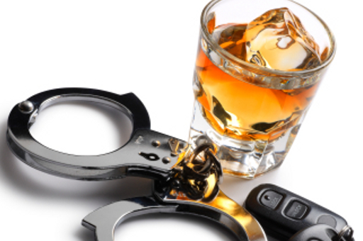
Introduction
Is it safe to get behind the wheel of a car?
Which drink is one too many?

Slide 3
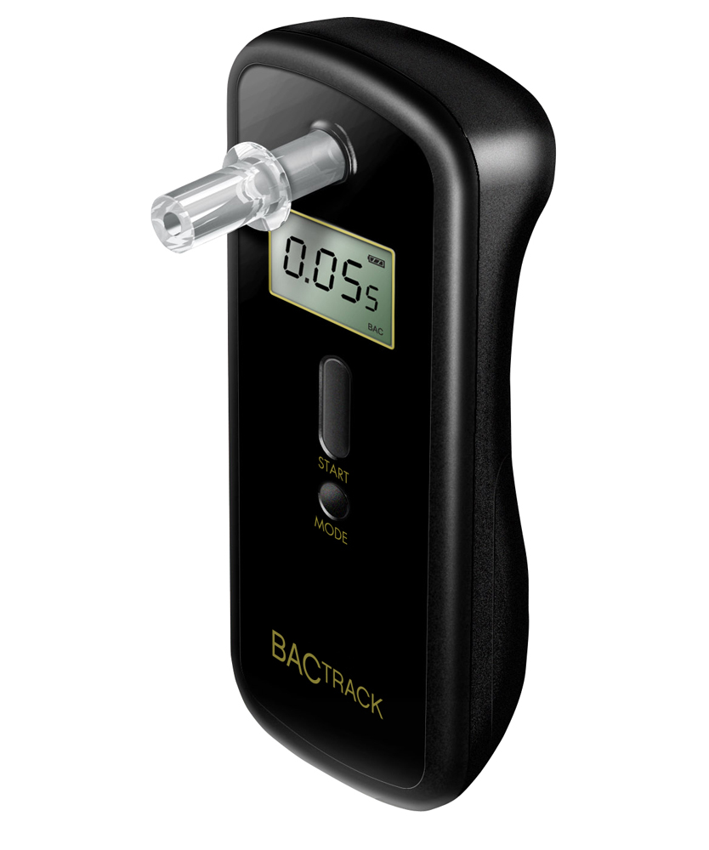
Breathalyzer

Slide 4
BAC Calculator

Slide 5
Best of Both Worlds
Wouldn’t it be nice...
?

Slide 6
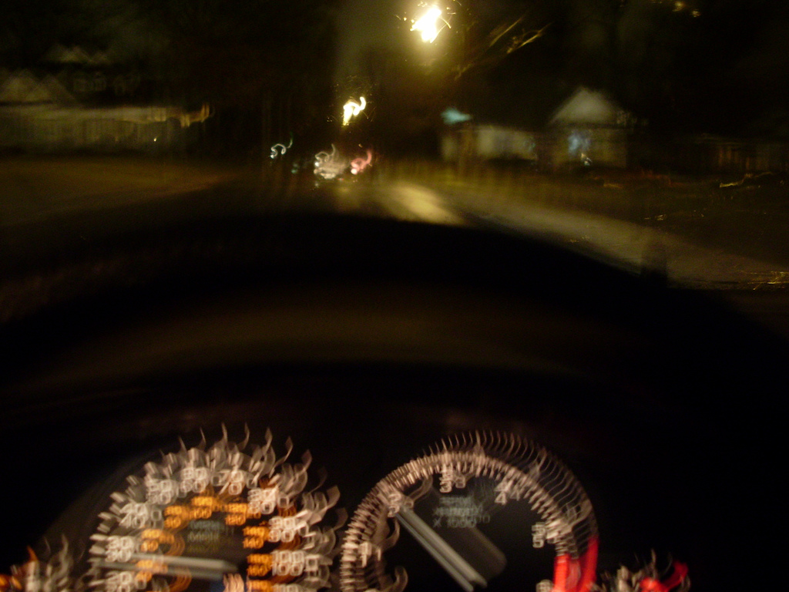
Measuring Effects of Alcohol
Memory
Problem solving
Fine muscle control
Vision
Reaction time

Slide 7
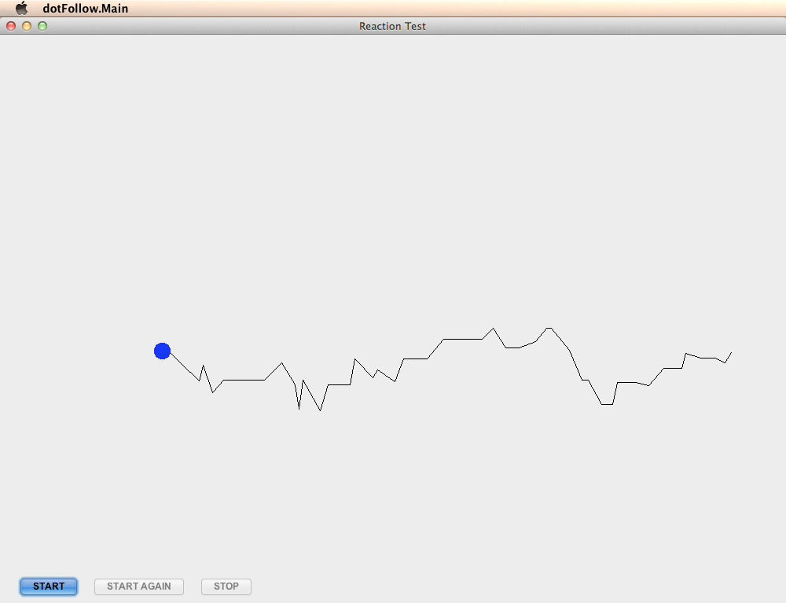
Problem Solving
Fine Muscle Control
Blurred Vision
Reaction Time
???
Memory

Slide 8
Experiment Design
Study
Evaluate prototypes/ develop eqn.
9 prototype tests
4 Java
5 physical

Slide 10
Physical – Math Progression
3
+
3
/
2
x
5
-
4
=

Slide 11
Data Collection
21 Subjects
“baseline sober state” score
1 – 4 trials depending on subject

Slide 12
Results
ANOVA^{b}
Model |  | Sum of Squares | df | Mean Square | F | Sig.
1 | Regression | 2.789 | 1 | 2.789 | 13.419 | .002ª
 | Residual | 3.950 | 19 | .208
 | Total | 6.739 | 20
Coefficientsª
Model |  | Unstandardized Coefficients |  | Standardized Coefficients | t | Sig.
 |  | B | Std. Error | Beta
1 | (Constant) | .329 | .134 |  | 2.455 | .024
 | BAC | -7.152 | 1.953 | -.643 | -3.663 | .002
Model Summary^{b}
Model | R | R Square | Adjusted R Square | Std. Error of the Estimate
1 | .643ª | .414 | .383 | .45593
Reliability Statistics
Cronbach's Alpha | N of Items
.754 | 9

Slide 13
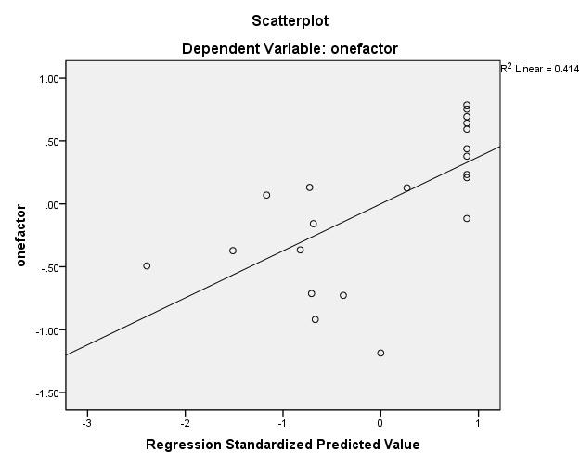
Results
R² Linear = .41
Standardized
Score
Blood Alcohol Content

Slide 14
Problem Solving
Fine Muscle Control
Blurred Vision
Reaction Time
???
Memory

Slide 15
Current Status

Slide 16
QUESTIONS?

